Slide 1
Air Pressure
The atmosphere is a blanket of gases around the planet.
Pressure = a force pushing on an object.
Air Pressure = the force of all the air (5 miles worth) pushing down on everything on the Earth’s surface.
Air pressure can change slightly from day to day based on weather systems.

Slide 2
Gravity & Pressure
Gravity is another force that acts to pull matter toward the center of the Earth.
So, the closer you are to the surface, the greater the force of gravity.
Air molecules are also affected by gravity.
As a result, there are more molecules near the surface and fewer as you move away from the surface.
This difference in the number of molecules changes the air density.

Slide 3
Altitude vs. Air Density
If you are at sea level (low altitude), the air pressure is high, and the air molecules are being squeezed tightly together. This means the air at sea level is MORE dense.
If you are at a high altitude, there is less pressure to squeeze the air together, so the air is LESS dense the higher you go.

Slide 4
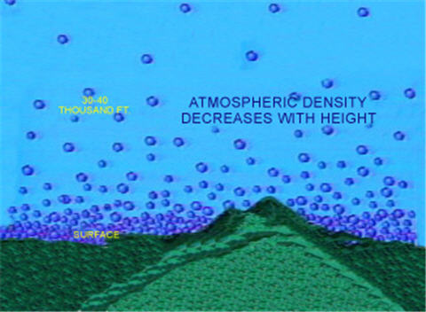
Atmospheric Density

Slide 5
Altitude vs. Pressure
Altitude = your height above sea level
As you increase in altitude, there is less atmosphere above you, so there is LESS air pressure.
The closer to sea level, the more air stacked above you, and the MORE the air pressure.

Slide 6
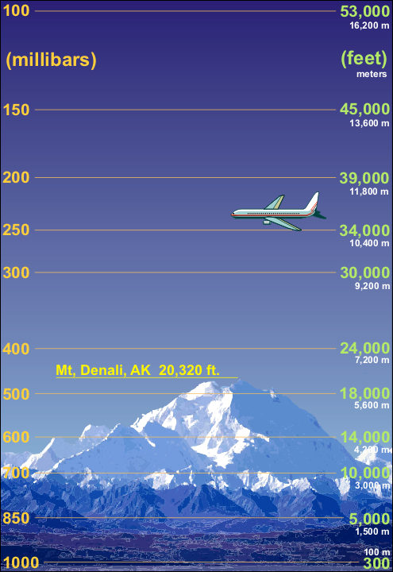
Instrumentation
Air pressure can be measured by one of two types of barometers.

Slide 7
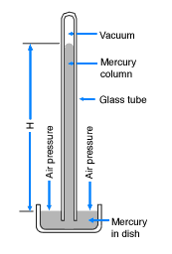
Mercury Barometer: Oldest type of barometer. Liquid mercury in a tube is pushed on by air pressure and rises.

Slide 8
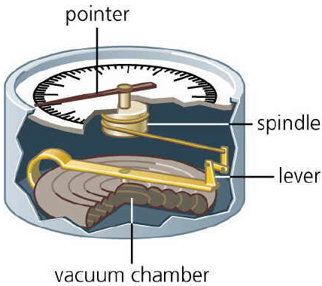
2. Aneroid Barometer- made of a tightly sealed metal container that flexes very slightly to changes in air pressure. The flexing moves a needle so you can read the pressure.

